Slide 1
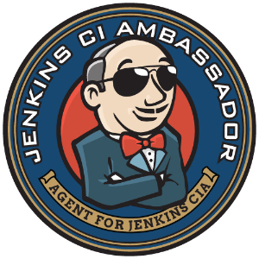
Jenkins
UI for your Powershell
presented by @nvarscar

Slide 2

about:me
Kirill Kravtsov - @nvarscar
PostgreSQL DBA at xMatters
Powershell enthusiast
Automation developer
DevOps supporter

Slide 3
agenda
Jenkins: introductions
Jenkins components
Agents
Jobs
Plugins
Jenkins & Powershell
Jenkins & SCM

Slide 4

introductions
The leading open source automation server, Jenkins provides hundreds of plugins to support building, deploying and automating any project.
https://jenkins.io

Slide 5

requirements
Java 8 (JDE or JDK)
(Optional) Docker
installation
Download Jenkins
java -jar jenkins.war --httpPort=8080
Or simply execute installation package
Browse to http://localhost:8080
Follow the instructions to complete the installation
Notes:
Level 1
Run the first catFact

Slide 6
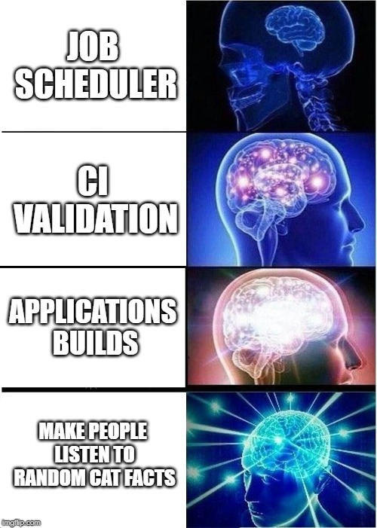
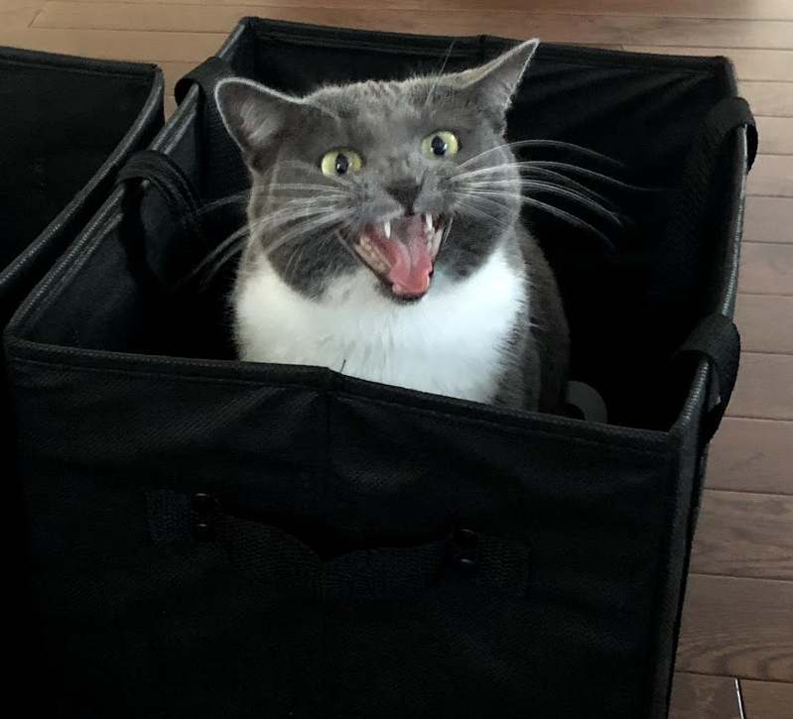
jenkins usage

Slide 7
overview
Web UI
Administration
Reporting
REST API
Executor 1
HTTP
Agent 1
(Windows 2012)
Executor 2
Jenkins
Master
(Any OS)
TCP 50000
SSH
Agent 2
(RHEL 7)
Executor 1
Executor 2
Executor 3
…
Job 1
Job 2
Job 3
Plugins
Email
Git
Powershell
Artifact management
Docker
…
…
Agent N
(other OS)
Executor 1
Executor 2
Notes:
Create new cat fact

Slide 8

jenkins agents
Executors
Each running job exclusively uses one of the available executors
If no executors available, jobs queue up on Master
YMMV, but start with # of CPU cores
Root directory
Configuration
Workspaces
Launch method
Windows service
SSH
Jar file
Docker
Labels
Logical groups
Agent 1
(Windows 2012)
Executor 1
Executor 2
Jenkins
Master
(Any OS)
TCP 50000
SSH
Agent 2
(RHEL 7)
Executor 1
Executor 2
Executor 3
…
…
Agent N
(other OS)
Executor 1
Executor 2
Notes:
Show Jenkins agent root

Slide 9
jenkins jobs
Executor
Workspace
3 phases of execution:
Pre-build tasks
Build
Post-build tasks
Job triggers:
Manually
Scheduled
From other jobs
From SCM
Parameters
Build History
Tracks changes from SCM
Past execution details
TRIGGER
Queue
Job
Artifacts
Logs
Jenkins master
Notes:
Job runs on one of the available executors in its own workspace
workspace is not persistent across all agents
Level 2

Slide 10

artifacts and logs
Are a part of the Build
Kept on master until the Build is deleted
Cleaned up based on Log rotation option
Cannot be added/removed/edited outside of the Build
Artifacts
Logs
Should be defined in the job
Can be aggregated in an upstream job
Can be marked as ‘keep indefinitely’
Can be copied from a different build
Stdout and stderr
Any log file worth saving should be treated as an artifact
Multiple steps produce a single output log
Photo by thesuccess at Morguefile.com
Notes:
Level 3 and 4

Slide 11







job types
Freestyle: bread’n’butter of Jenkins
Pipeline: code-based job definition for advanced scenarios
Declarative pipeline
Scripted pipeline
Multibranch pipeline
Ideal for CI
Multi-configuration (Matrix)
Labels to run builds using multiple agents
User-defined axis
Notes:
Level 5

Slide 12

plugins
Plugins extend the functionality of Jenkins.
Recommended plugins are set up once during Jenkins post-setup initialization
Include SCM integration and most popular automation and visualization modules
Controlled by Plugin Manager:
Displays a list of available and installed plugins
Performs install/uninstall plugin tasks
Files are downloaded from Jenkins website
Notifies about updates and installs them

Slide 13
useful plugins
Active Directory - enables authentication through Active Directory
Blue Ocean - beautiful interface to build and control pipelines
Build Pipeline - adds a dashboard that can show jobs chained together into a build pipeline
Build Timeout - terminates the build after predefined amount of time
Conditional BuildStep - adds conditions to the job steps if necessary
Copy Artifact - copies artifacts from previous builds/other jobs
Email Extension - enhanced email experience
Parametrized Trigger - allows to trigger jobs with parameters
Powershell - allows to run Powershell scripts or ad-hoc commands
Promoted Builds - promotes build status based on certain criteria and adds a possibility of manual interactions in the job chain (aka manual promotion)
Rebuilder – adds a Rebuild button to the job page
Workspace Cleanup - allows to cleanup the workspace before/after build

Slide 14
scm integration
Store your scripts in a source code repository. Why?
The executed code is always up-to-date
Natively supported by Jenkins
Change history
Quick rollbacks if needed
Branching
CI
master
hotfix
develop

Slide 15
CI for your code
Writes tests to test your code!
Use Pester. No, really.
Negative tests are equally important
Jenkinsfile
Action file for Jenkins
Multi-branch pipeline
Track branches and PRs in your repository
Trigger CI on commits
Develop
Test
Deploy
Notes:
Level 6

Slide 16
tips and tricks: agents
Dynamic agents by using docker containers
# of executors can be your parallel execution limiter
Agents for interactive activities work better when started from a live session
Windows agents created through DCOM require some configuration on the target host

Slide 17
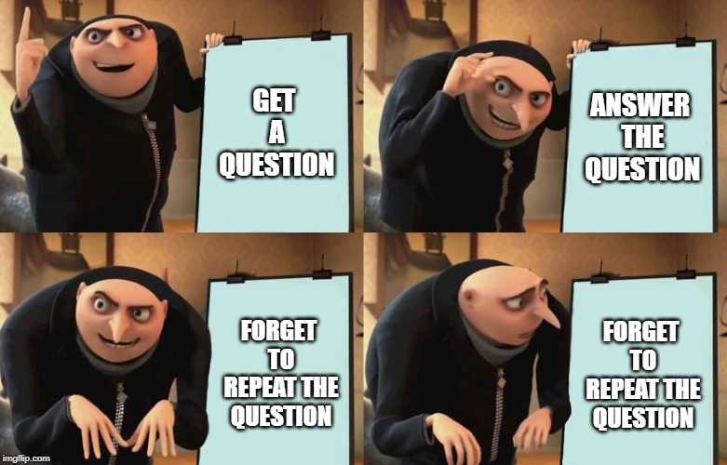
Q&A

